Slide 1

Web scraping to gain company insights

Slide 2
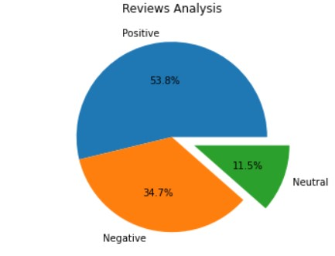
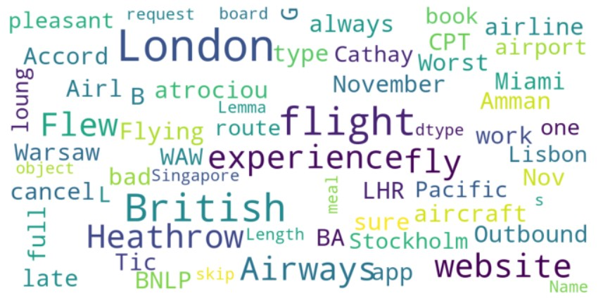
Insights from customer reviews:
Upon conducting a comprehensive analysis of 1000 customer reviews, we derived the following results:
Positive Reviews – 538
Negative Reviews – 347
Neutral Reviews – 115
Keyword Visual Representation Derived from Customer Reviews:

